Slide 1


Slide 2

  General useable solution common reoccuring problems
  Blue print to solve a problem
  Predefine testable implemented solution
  Obtain by trail and run

Slide 3

  In 1994, A book was published
  Erich Gamma
  Richard Helm
  Ralph Johnson
  John Vlisside
  These all collectively known as GoF (Gang of four).

Slide 4


Slide 5
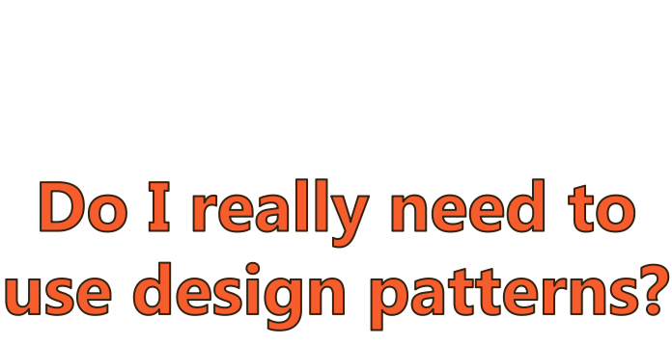

Slide 6

No, It is not necessary and compulsory to use design pattern in your code.
BUT....

Slide 7
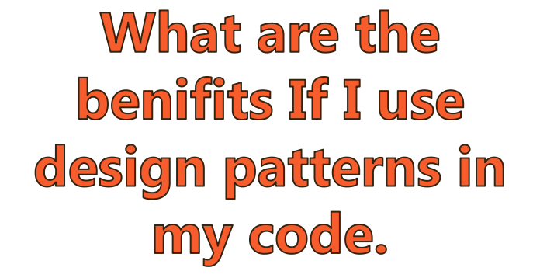

Slide 8

Using testable/Proven solutions
Code readability
Maintaibility
Easy extension
Following Industry Standards
Speed up the development
Career motivation
Clear code

Slide 9

As per the GoF there are 23 design patterns that fall under the three category
Creational
Structural
Behavioral

Slide 10
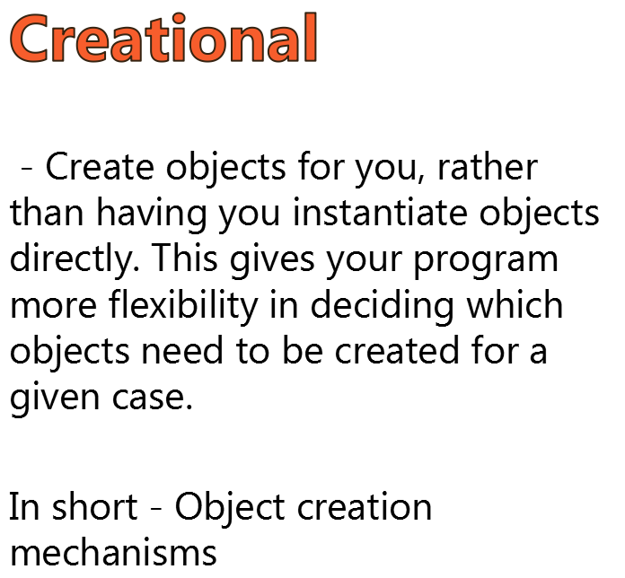

Slide 11


Slide 12
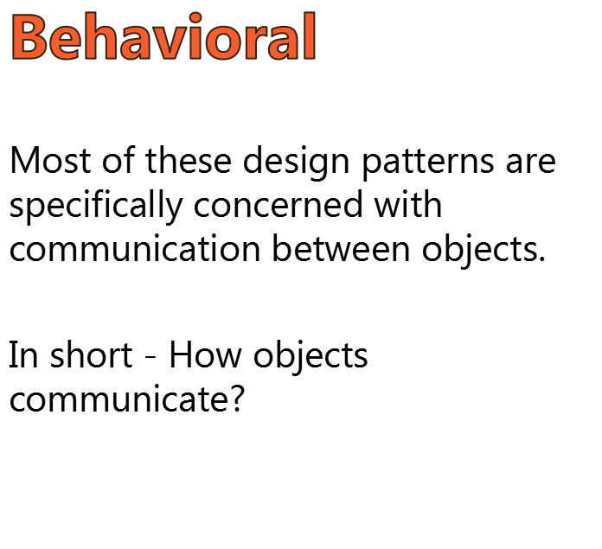

Slide 13

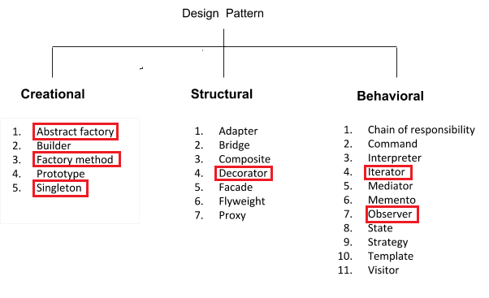

Slide 14


Slide 15
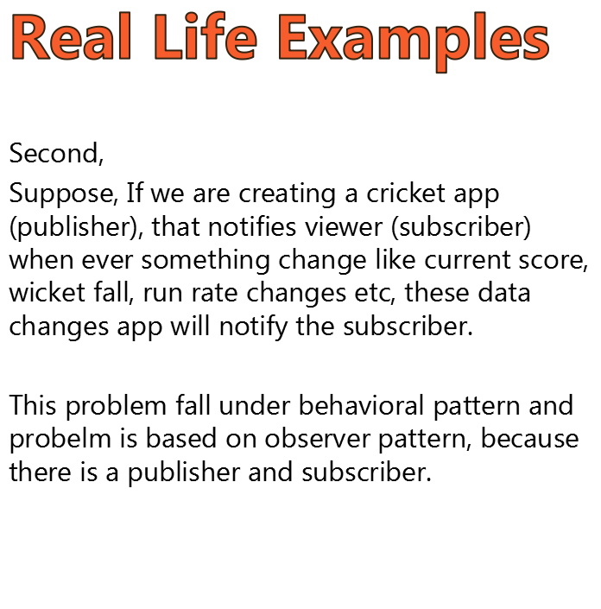

Slide 16
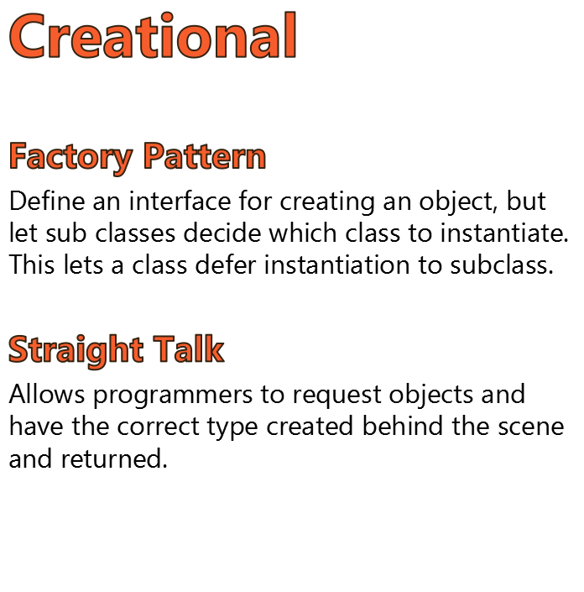

Slide 17
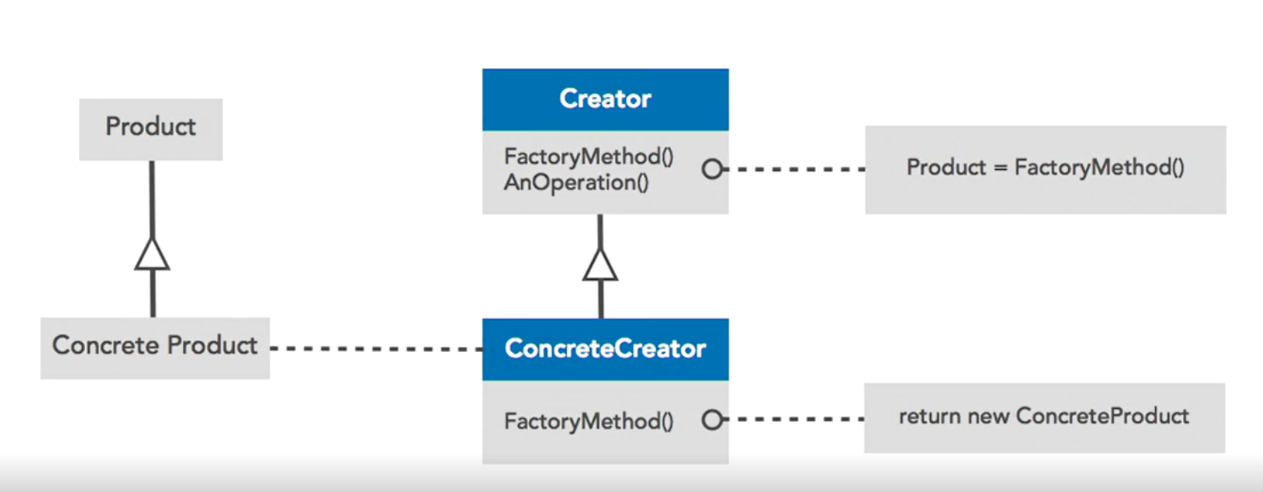

Slide 18
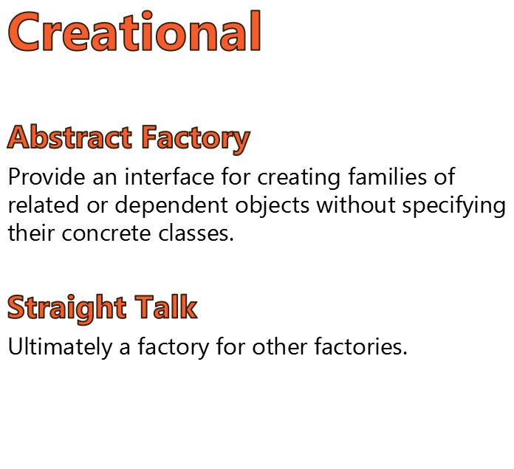

Slide 19
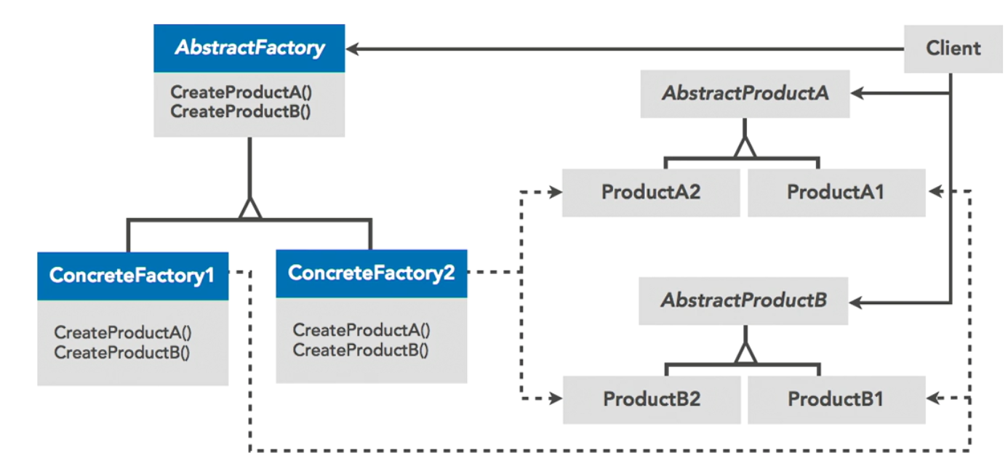

Slide 20
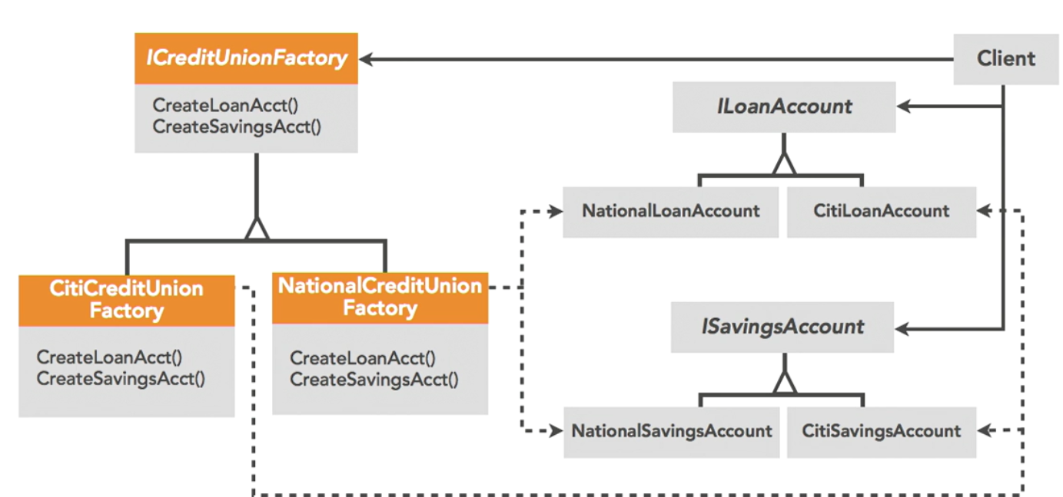

Slide 21
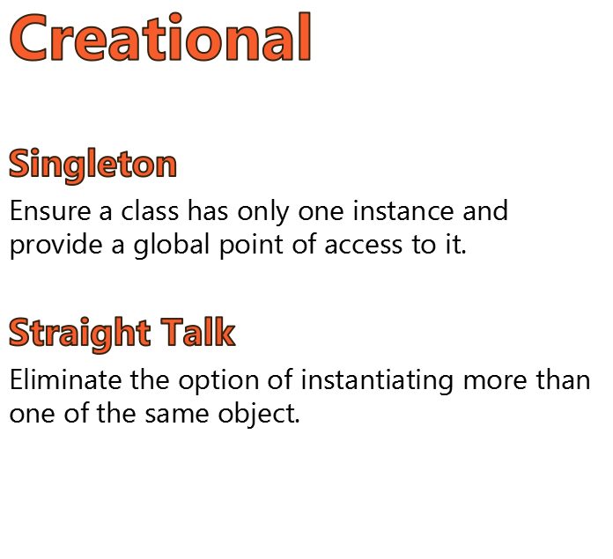

Slide 22
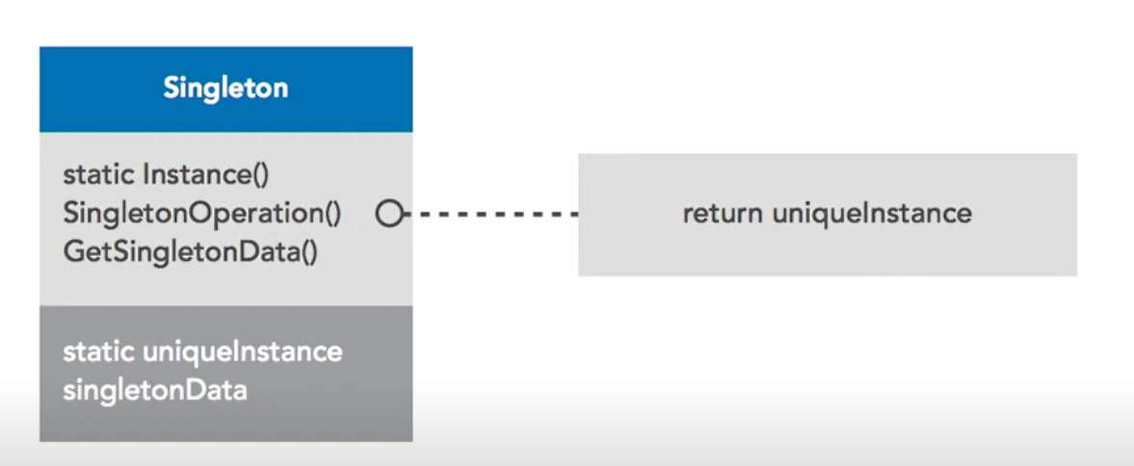

Slide 23
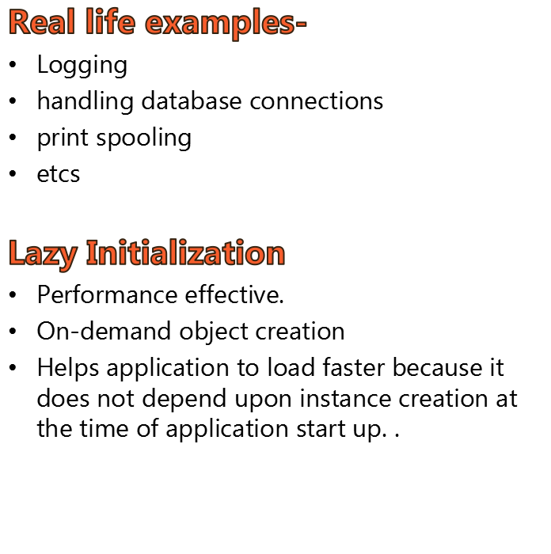

Slide 24


Slide 25
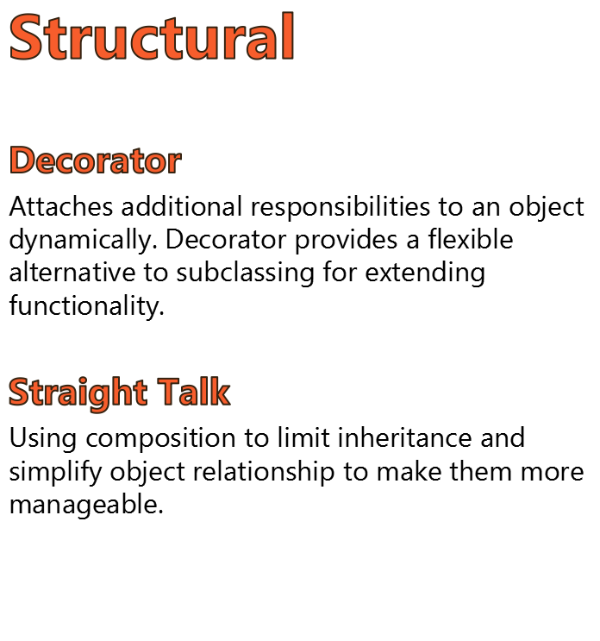

Slide 26
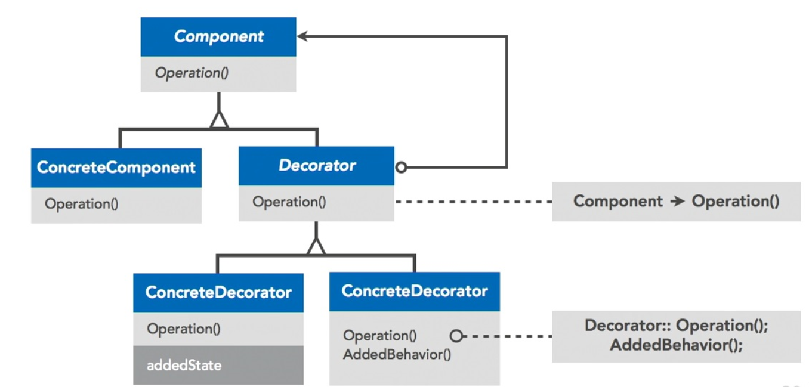

Slide 27
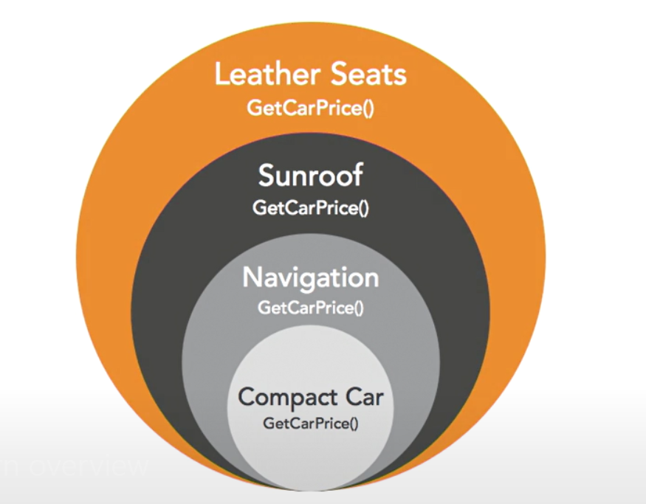

Slide 28
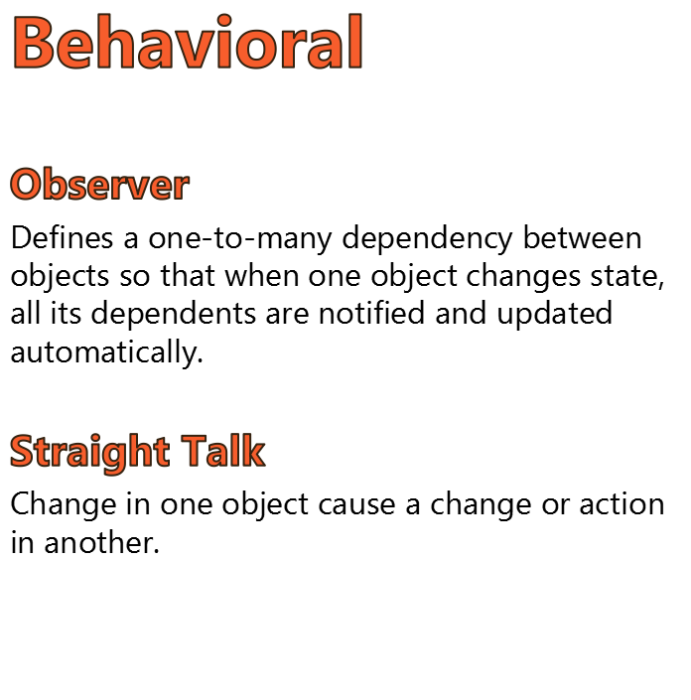

Slide 29
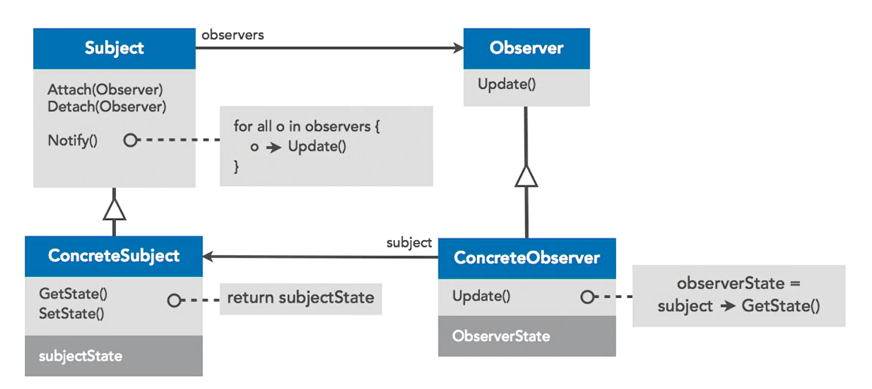

Slide 30
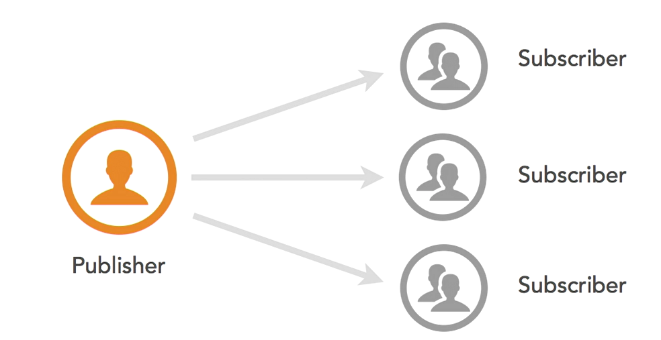

Slide 31
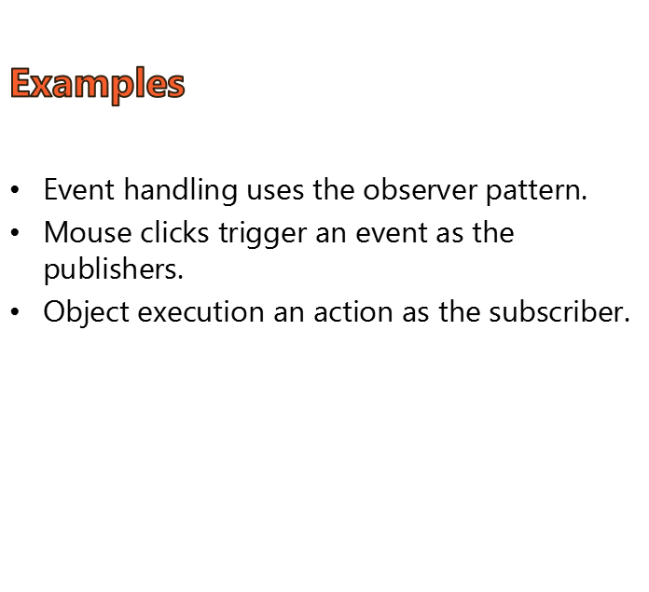

Slide 32
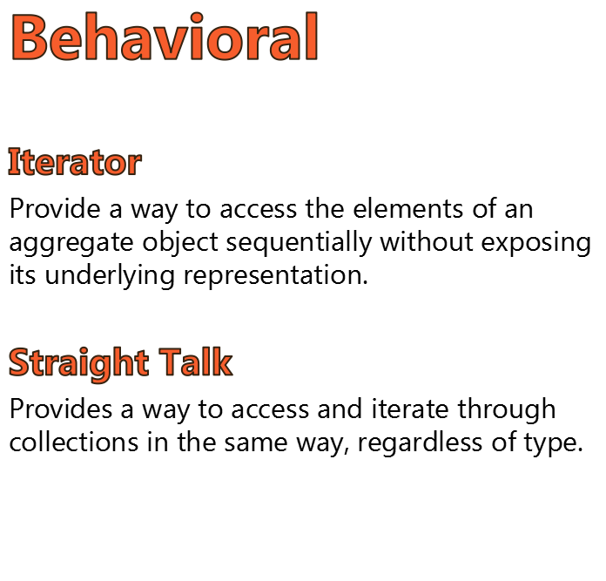

Slide 33
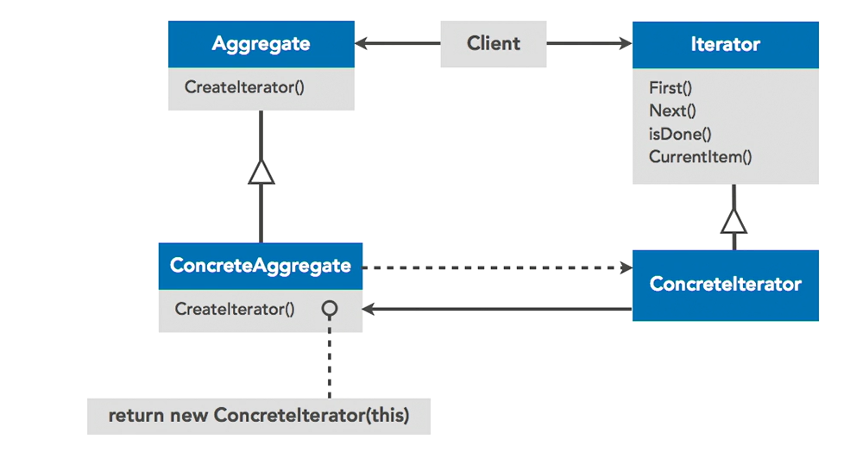

Slide 34


Slide 35


